Slide 1
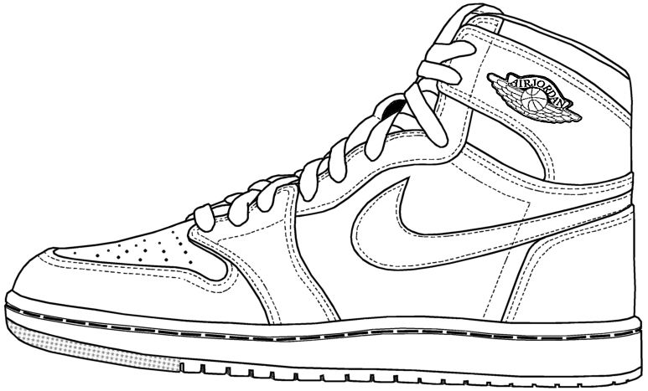
Predicting Sneakers
Using Machine Learning and Twitter Data to Predict Successful Sneakers Launches
By Team 1
Notes:
-?

Slide 2




Our Team
Ardavasd
Gabriel
Lucas
Javier
Notes:
?

Slide 3
Table of Contents
1
2
3
Business Model
Data Collection
Data Analysis And Conclusions
Notes:
-?

Slide 4
1
Business
Model
Notes:
-Gabe

Slide 5
Business Model Canvas
Business Inputs Operating Costs Customer Base
Twitter Data
Release Calendars
Retail vs Resale
DB Management
Computing Power
API Access
Sneaker Brands
Retailers
Other Online Resellers
Notes:
-Gabe
Business Inputs: Relevant Twitter data, sneaker release calendars, sneaker retail and current resale prices
Operating Costs: Database management (Large storage capacity), computing power to run model, API access
Who Are Your Customers: Large sneaker brands, retailers, large resellers, other large brands (in the future)

Slide 6
Business Model Canvas
Key Activities
Key Resources
Revenue Stream
ML Algorithms
Database
Data Gathering
Data Dashboard
Consulting Retailers
Forecast Consulting
Price Predictions
Consulting
Notes:
-Gabe
Key Activities: Price predictions for future releases - make more money on resale market, consulting - forecasting releases to focus on and attempt to optimize stock
Key Resources: Machine learning algorithms, database, data gathering methodologies, data dashboard that we create for the customer
Revenue Streams: Consulting other retailers to help them manage inventory of sneakers, consulting brands to help them forecast profitability of particular silhouettes, optimize release calendar(manage hype), optimize future business decisions

Slide 7
Minimum Viable Product
Core product is data science consulting
Three key components:
Data Gathering Data Analysis Data Reporting
Notes:
-Gabe
Our minimum viable product is our analysis and resale price predictions of the sneaker launches on Nike's SNKRs application for the past week.
The core of our business is our data science consulting. As Randy mentioned in the videos, the data science product has three key components: data gathering, data analysis, and data reporting.
Data gathering is the collection of the actual data itself. To continuously gather data, we plan on continuously gathering data from the Twitter API that would then be stored in our database management system. For our minimal viable product, we are running the searches manually on a daily basis, but we would automate this process as the company matures. Additionally, while we have not decided a final database company to rely upon, we plan to use MongoDB Atlas for the foreseeable future.
CAP Theorem states that it impossible for a distributed computer systems to simultaneously provide availability, consistency, and partition tolerance. MongoDB, the database used in DS3010, offers consistency and partition tolerance, but only limited availability. Given that our work is not very time sensitive, we think that availability is not as important as consistency and partition tolerance.
The next aspect of our data science product is data analysis. Our data comes from multiple sources; internal customer data, StockX data, and Twitter data. The business problem we are trying to solve is how to use data to build a machine learning model that predicts the value of various shoes on the resale market. Using our machine learning algorithm, we will be able to highlight indicators of successful releases. We then plan on using those indicators to predict the success of future releases and help Nike have more successful releases in the future.
The final aspect of our data science product is data reporting. To ensure customer access, we plan on posting both the data and our analysis in a Tableau dashboard.

Slide 8
2
Data Collection
Notes:
-Lucas

Slide 9

Building Our Dataset
Querying a list of hashtags relevant to releases
Querying the past seven days
Building collections for each unique entity being searched
Notes:
-Lucas
The goals of our data gathering methods were to structure them to scale to be automated as a larger product. We accomplished this by building a list of queries we wanted to make, which in the case of this product demo were relevant hashtags for the shoes that were releasing since February 26th on Nike’s SNKRS app. We did this by searching for tweets with each hashtag every day for the past week that were stored in a collection unique to the hashtag itself so that we can track its usage over time. These functions run automatically while staying under the twitter API rate threshold and all data collected was stored in a MongoDB cluster. Let’s explore how we were able to accomplish this

Slide 10
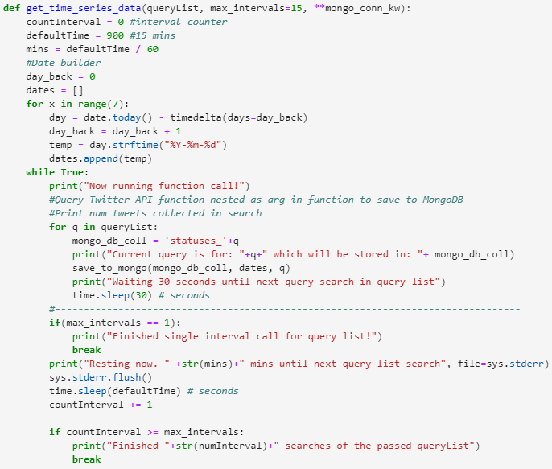
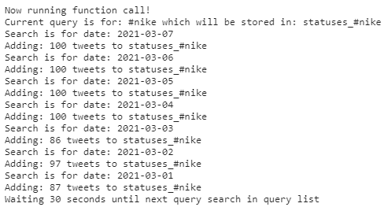
Running Our Queries
each interval is len(queryList)*30 secs + (numIntervals-1)*15 mins long
Notes:
-Lucas
Heavily modifying our code from case study 2 our team was able to successfully search through our list of queries every 30 seconds for an entire week, at the bottom we generated an expression for the total time it takes for a variable run to complete, this is incredibly helpful as by building our algorithm with this in mind we were able to avoid being rated limited by twitter, do note that each individual twitter search was for a maximum value of 100 tweets which you can see on the right.

Slide 11

Additional Data
Notes:
-Ardy
When obtaining our other indicators such as resale value we were hoping to automate this process by being able to query sneaker listings off of StockX but unfortunately there is no public API currently. To circumvent this our team hardcoded a csv value of all the potential indicators there could be for a sneaker. The result is 13 attributes that include the silhouette of the shoe(the make), is it a collaboration if so what company, is it a women’s shoe as this affects shoe sizes, is it a rerelease, the colorway(color of the make), the retail price, the resale price, the size of the shoe referenced, the marketplace the resale price was grabbed from, relevant hashtags, and search terms. While we weren’t able to use all indicators for our demo today, we see their incredible use given time to scale our prediction model.

Slide 12
3
Data Analysis and Conclusions
Notes:
-Javier

Slide 13
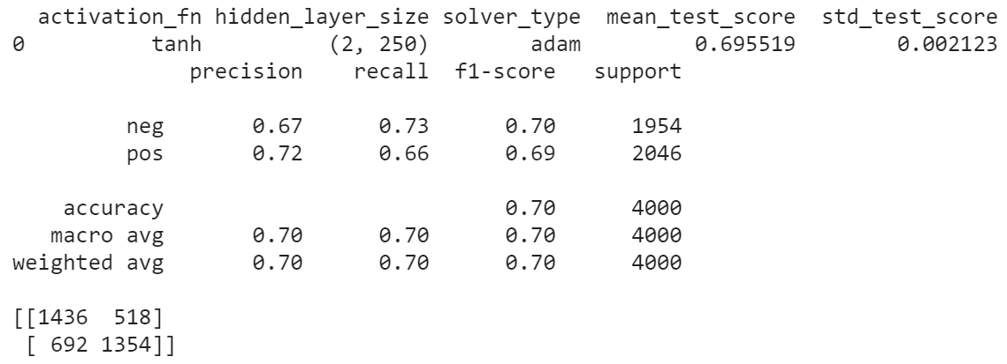
Part 1: Train Sentiment Model
Model Testing done in Colab
Training MLP on 40,000 tweets
Accuracy ~70%
Notes:
-The first portion of our product involves training a model to perform sentiment analysis. We tested several models on google colab using subsets of the dataset found by group 2 on Kaggle with 1.6 million tweets. Since we didn’t use Colab for the rest of the project, we stuck with a subset of 40 thousand tweets to save on time.
The model’s accuracy in predicting sentiment was around 70%. We used a MLP and checked models with cross-validation.

Slide 14
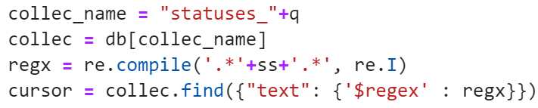
Part 2: Regular Expressions
Iterate over collections
Search for strings within text of tweet
Add each tweet into table for sentiment analysis
Notes:
The second part of this was separating the data we had in our database into sets of tweets discussing different shoes. For this we used regular expressions to hunt down various strings that could come up when people were discussing a shoe, including some possible misspellings. We’re aware that .* is pretty greedy and we struggled to get the DOTALL flag working. Ultimately though, we were able to create a dataframe for each shoe type with the corresponding tweets.

Slide 15
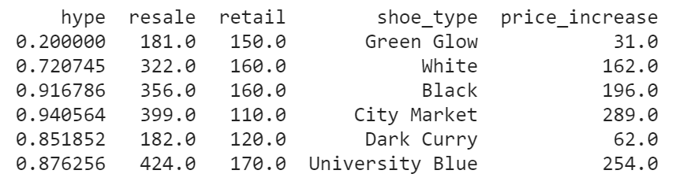
Part 3: “Hype” Index
SA on all tweets related to a single shoe
Hype = positive tweet count divided by total tweet count
Notes:
-What is the hype index? I’ll get there. With the dataframes we had for the types of shoe, we performed Sentiment analysis on each of these at a time. We would generate the list of the predicted sentiment and use this to calculate our hype index. Essentially, we would sum up all the predicted positive tweets and divide that by the total tweets. We expected that as this number increased, so would people’s willingness to pull out their wallets.

Slide 16
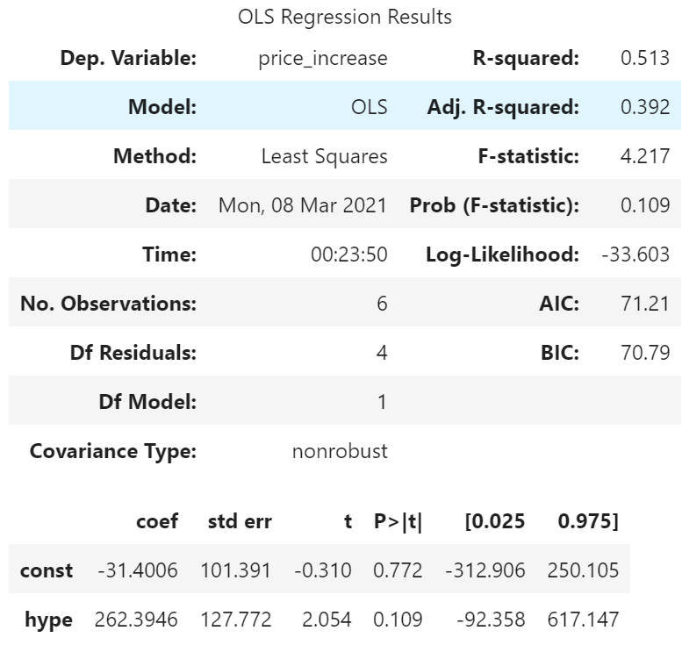

Part 4: Regression
Price Increase as a function of Hype
Only 5 data points to fit model
Notes:
-This part of the product is the part where we expect the best increase in performance as the duration of its deployment increases.
We fit a simple linear regression to predict the increase in price as more hype takes place. We settled on this since we only had 5 data points for this model. As you can see, the hypothesis test gave us a pretty unimpressive p-value

Slide 17
Room to Grow
Model accuracy will increase with more data
New Releases several times per week
Can make better models with more predictors (instead of SLR)
Notes:
-Javier

